Slide 1
MAT 350 Engineering mathematics
Modeling with 2nd order ODE:
Mass–Spring System.
Lecture: 5
Dr. M. Sahadet Hossain (MtH)
Associate Professor
Department of Mathematics and Physics, NSU.

Slide 2
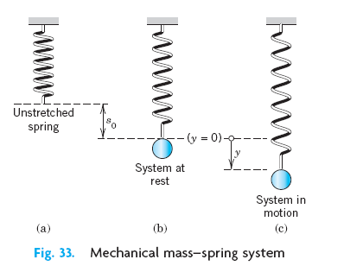
Modeling of Free Oscillations of a
Mass–Spring System
Linear ODEs with constant coefficients have important applications in mechanics, and in electrical circuits.
In this section we model and solve a basic mechanical system consisting of a mass on an elastic spring (a so-called “mass–spring system,” Fig. below), which moves up and down.

Slide 3



(1)
(2)
If the damping is small and the motion of the system is considered over a relatively short time, we may disregard damping.
Then Newton’s law with F=- F₁ gives the model
(3)

Slide 4



This is a homogeneous linear ODE with constant coefficients. A general solution is obtained as
(4)
This motion is called a harmonic oscillation. Its frequency is
The frequency f is called the natural frequency of the system.
Please note,

Slide 5

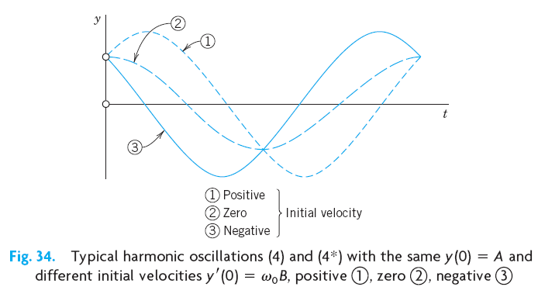
An alternative representation of (4), which shows the physical characteristics of amplitude and phase shift of (4), is

Slide 6

Modeling of Free Oscillations of a Mass–Spring System
Example 1: If a mass–spring system with an iron ball of weight W=98 nt (about 22 lb) can be regarded as undamped, and the spring is such that the ball stretches it 1.09 m (about 43 in.), how many cycles per minute will the system execute?
What will its motion be if we pull the ball down from rest by 16 cm (about 6 in.) and let it start with zero initial velocity?
Solution. Hooke’s law with W as the force and 1.09 meter as the stretch gives
W= 1.09 k (since W=ky, y displacement)
Generate mathematical model
Frequencey, f =

Slide 7

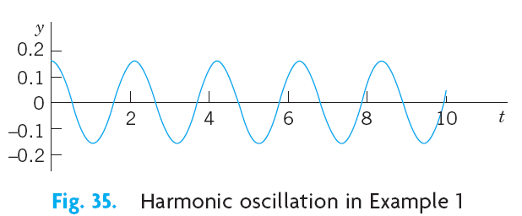
Initial conditions
Note that we have,
. Hence
Hence B=0, and δ = tan⁻¹ (B/A)=0,
Therefore, the general solution is:
Here, 16 cm=0.16 m
C=sqrt(A²+B²)

Slide 8


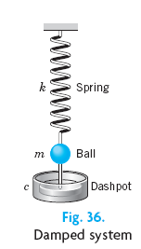




ODE of the Damped System

Slide 9

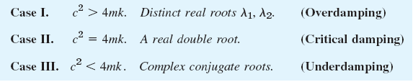

Slide 10


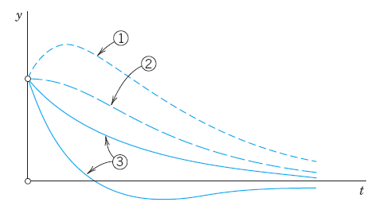
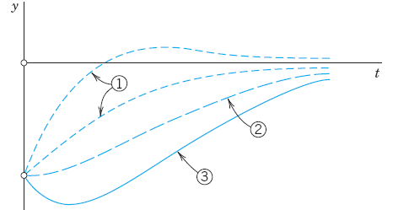


Slide 11


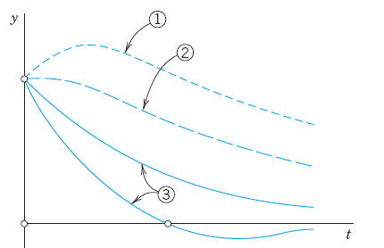
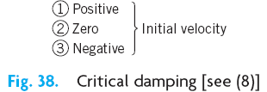

Slide 12





Slide 13

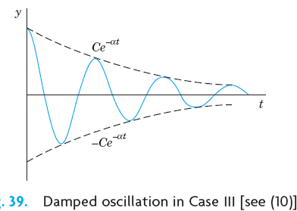

Slide 14

Examples: from Zill 10th edition.
Example 2: A mass weighing 2 pounds stretches a spring 6 inches. At t=0 the mass is released from a point 8 inches below the equilibrium position with an upward velocity of 4/3 ft/s.
Determine the equation of motion.
SOLUTION:
Because we are using the engineering system of units, the measurements given in terms of inches must be converted into feet
In addition, we must convert the units of weight given in pounds into units of mass.

Slide 15




Here the negative sign in the last condition is a consequence of the fact that the mass is given an initial velocity in the negative, or upward, direction.
Thus, the equation of motion is

Slide 16
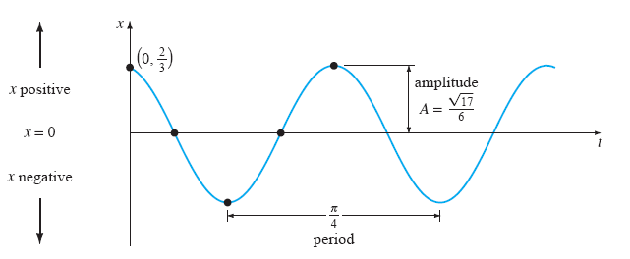

Slide 17


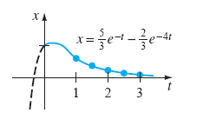
Example 3: Overdamped motion
Consider the overdamped motion described by the equation below. The mass is initially released from a position 1 unit below the equilibrium position with a downward velocity of 1 ft/s.

Slide 18
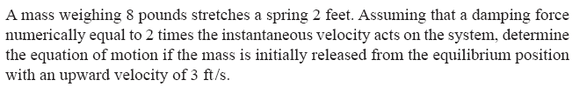
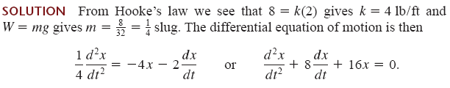

Example 4: Critically damped
Auxiliary equation is:

Slide 19

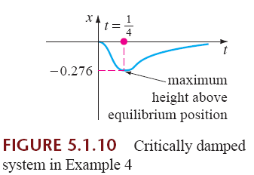

Slide 20
Example: (Underdamped condition)
A mass weighing 16 pounds is attached to a 5-foot-long spring. At equilibrium the spring measures 8.2 feet. If the mass is initially released from rest at a point 2 feet above the equilibrium position, find the displacements x(t) if it is further known that the surrounding medium offers a resistance numerically equal to the instantaneous velocity.

Slide 21




Consider the motion in Example 1 (of free oscillation) change if we change the damping constant c from one to another of the
following three values

Slide 22


Slide 23



Since c =10 is smaller than the critical c, we shall get oscillations.

Slide 24
